Slide 1
SantoshiCoin -- A BlockChain Application
Haoqi Huang, Jianxi Li, Ruifeng Wang

Slide 2
Description
The project is a digital currency transaction platform, which leveraged the concept of BlockChain, and decentralized data management.
The application focuses on the EcoSystem architecture, design of BlockChain, consensus algorithms, and the transaction process handling.

Slide 3
ROLES & DUTY
System Admin: manage networks, enterprises, and enterprise admins
Enterprise Admin: manage organizations, employees, and user accounts
Trader: request, or send coins to another trader. Buy or sell cash with cashiers.
Miner: Validate and write transactions to ledger. Mine a new block and add it to the most current blockchain
Cashier: Set sell or buy prices, approve transactions with traders
System Admin
Enterprise Admin
Trader
Miner
Cashier

Slide 4
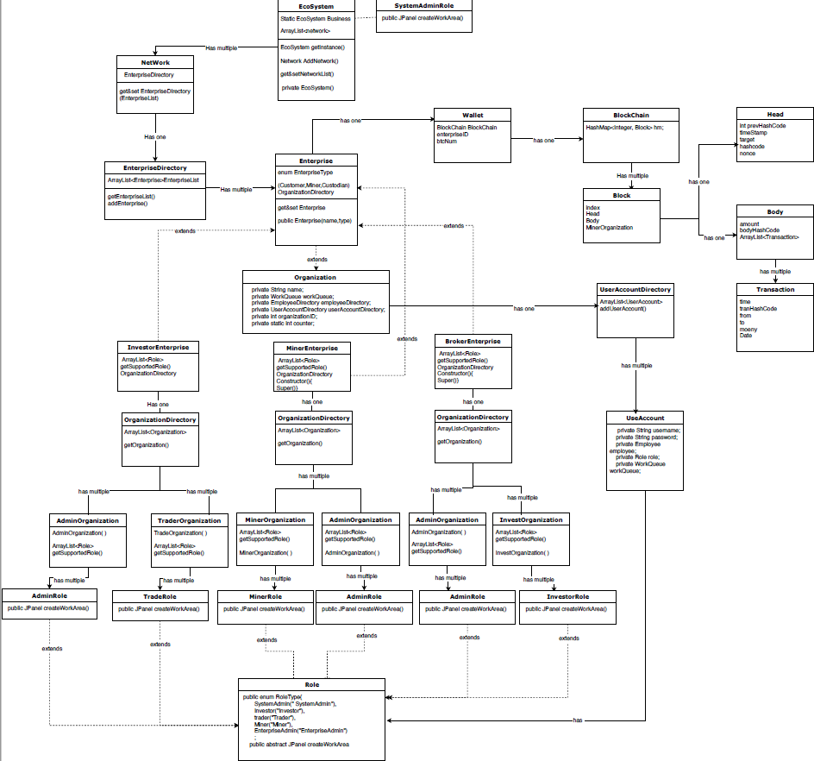
Object model

Slide 5
Approaches/How-to
Search Newest BlockChain API: loop through all enterprises and looking for the longest BlockChain, if two BlockChain has a same length, check who has longer transaction array list, then return the found blockchain.
Show All Transaction API: another API who extends searchNewestBlockChainAPI, will first search for newest blockchain, then loop through every block, and every transaction array list.

Slide 6
Transaction Model
Peer 2 Peer Transaction
Make a request or send SantoshiCoin is executed by a trader and 2 traders get involved
SantoshiCoin transaction must be verified by 3 miners before written to ledger
Cash Transaction
Traders can select any cashier to sell or buy coins on listed price
Cash Flow is between trader and Cashier, and yet, transactions need to validated by miners

Slide 7
P2P Transaction
Users either send or request coins to/from another user
Miner will validate the transaction by checking if the coin sender has enough coins
The system will search for newest blockchain and update current user’s blockchain
sendCoin()
requestCoin()
approve()
validate()
writeLedge()
updateBlock()
If requesting, the other user could approve it, or decline it
Then miner will write this transaction to the most current block in the chain

Slide 8
Cash Exchange
As a Cashier,you should post your expectations to the market...
Cashier should deal with the requestand cash is supposed to be paid.
Then miner will write this transaction to the most current block in the chain.
Setprice()
WQ.add(request)
Approve &
Decline
Validation
Update needed!!!
If a trader is willing to make a transaction,he gonna make a request
Miner will validate the transaction by checking if the coin sender has enough coins

Slide 9
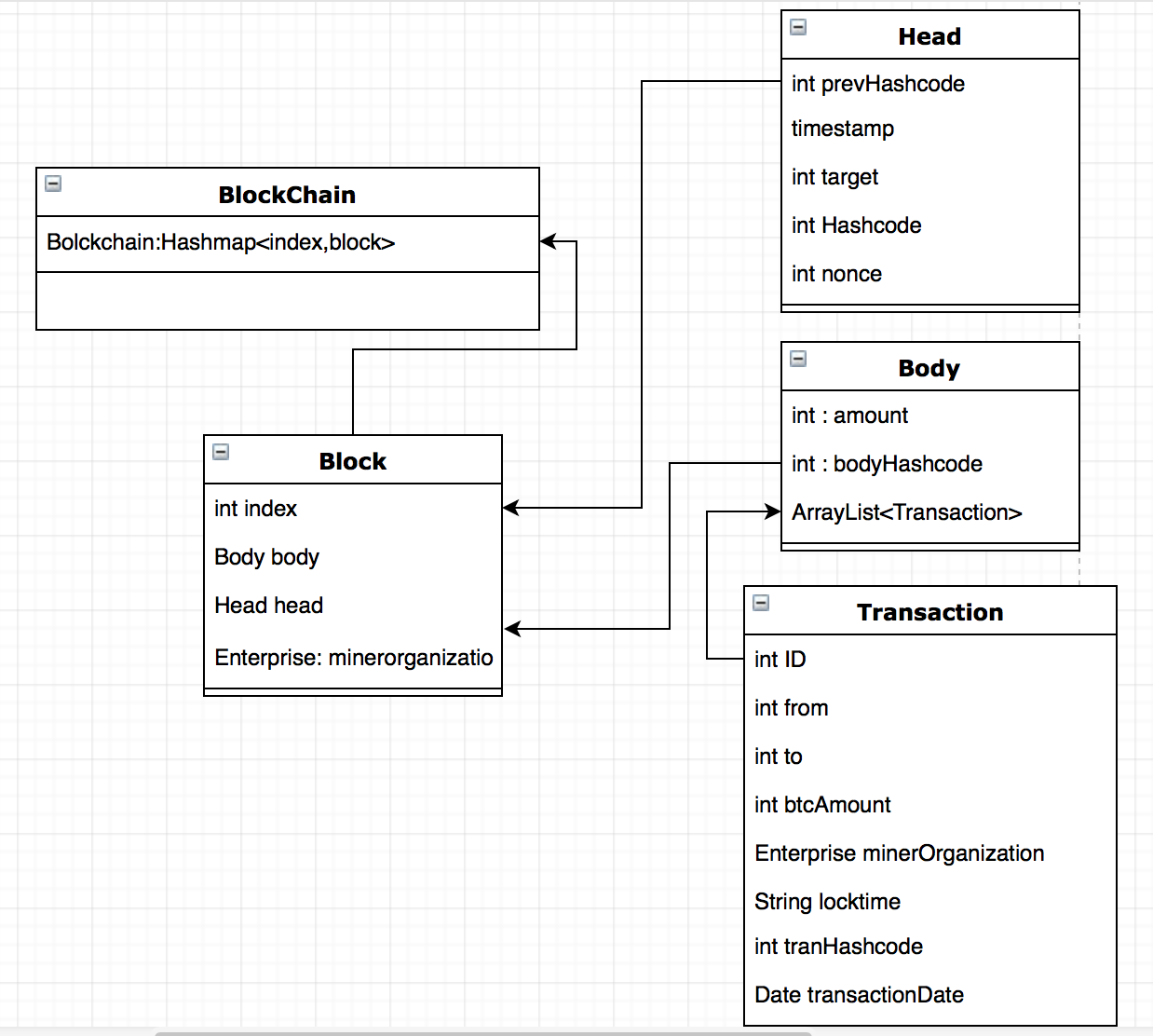
BlockChain Design
Structure
In this project, the structure of blockchain is simulated by HashMap, the key is the index and the Block store in the value of the HashMap.
Inside the block, there are head to store the attribute and body to store the transactions.

Slide 10
Technology of Decentralize
Consensus Algorithm
Unlike the centralized system, there is no dominator in this system.
A consensus algorithm has been published to keep the reliability.
Mining New Blocks
The randomly added blocks raised the safety of this system.
The transactions will be added to the most recently blocks if it was validated after the block generated.

Slide 11
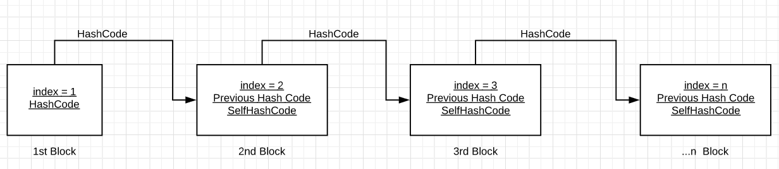
The Hashcode stored in the head of the Blocks, meanwhile it store the previous Hashcode to make sure that it’s the valid next block.
The block’s Hashcode is computed by merging the hashcode of transactions stored in this block’s body.
With the number of block grows, the difficulty of substituting the transactions stored in the previous blocks will sharply increased.
This structure ensure the safety of the blockchain.

Slide 12
Screen Shots

Slide 13
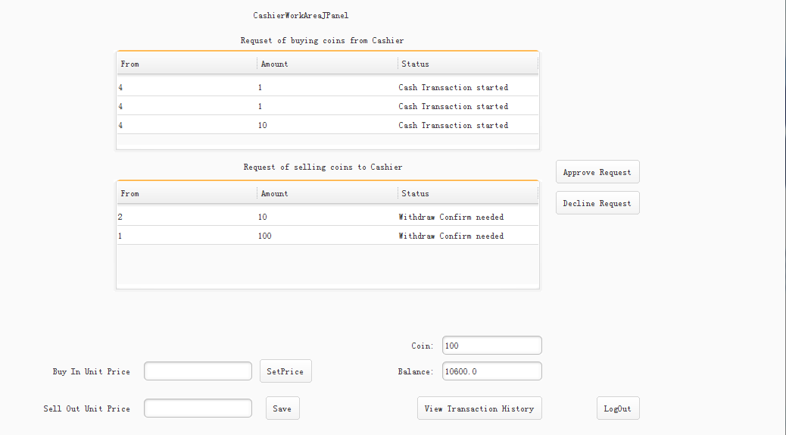
Cash Exchange
Cash Transaction’s cash flow is between cashiers and traders.

Slide 14
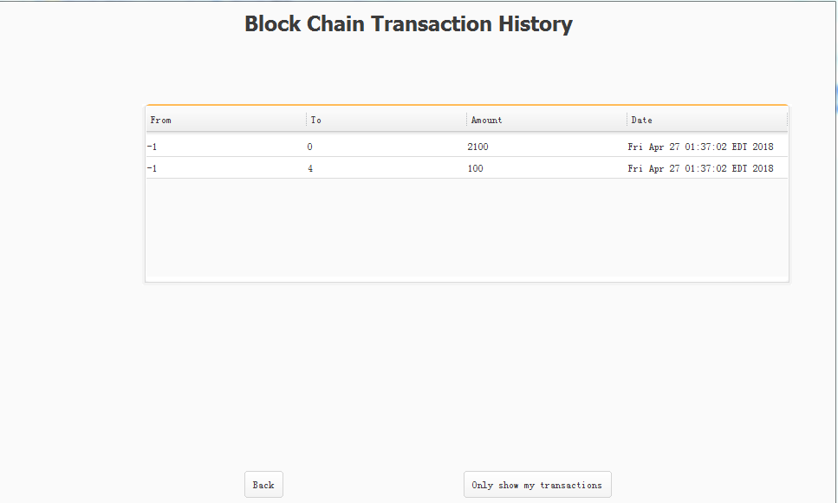
Transaction History
Transaction history is read from blockchain and accessible for every user.

Slide 15
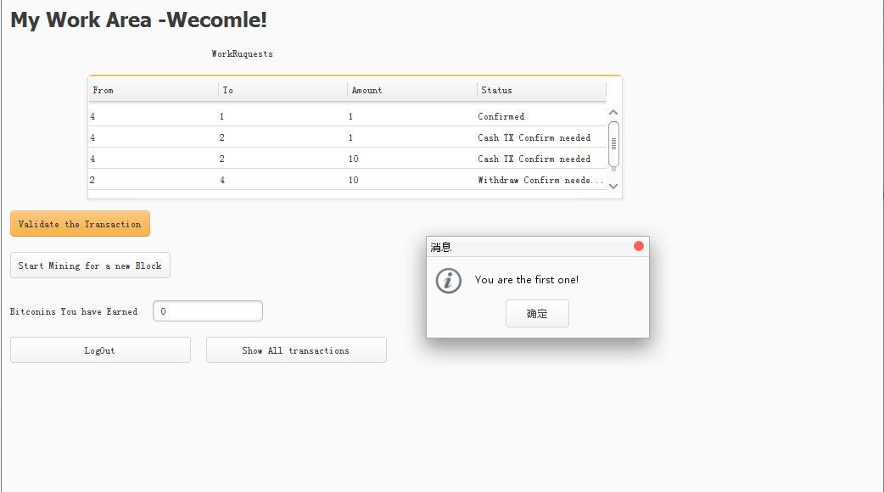
Validation Progress
Validation Progress is handled by miners and three miners is required for a whole validation progress.

Slide 16
Thanks !
What’s the difference between bitcoin and NASA?
-BItcoin’s actually going to the moon

